Slide 1
Are you aware of the danger behind plastic pollution?
speaker : 統計系 112級 李宗祐 Group 6

Slide 2
Opening
how many plastic wastes that you make everyday?
18 billions kg / year
→135 circles of the earth

Slide 3
Outline
1.effects to environment
2.effects to ourselves
3.ways to improve

Slide 4
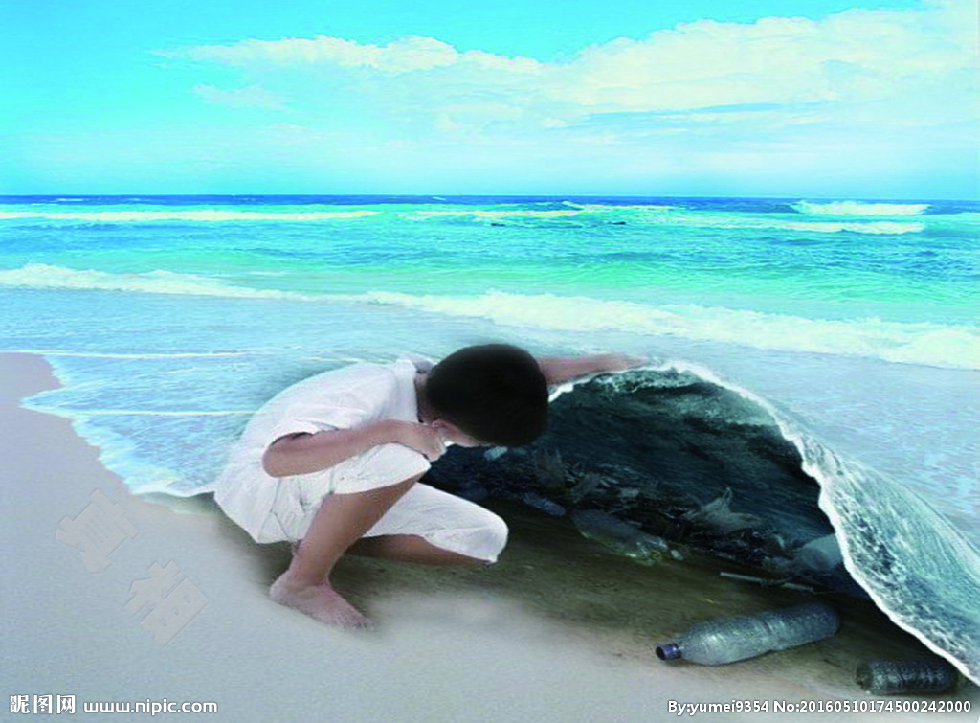
Effects to environment
ocean pollution
Air pollution

Slide 5
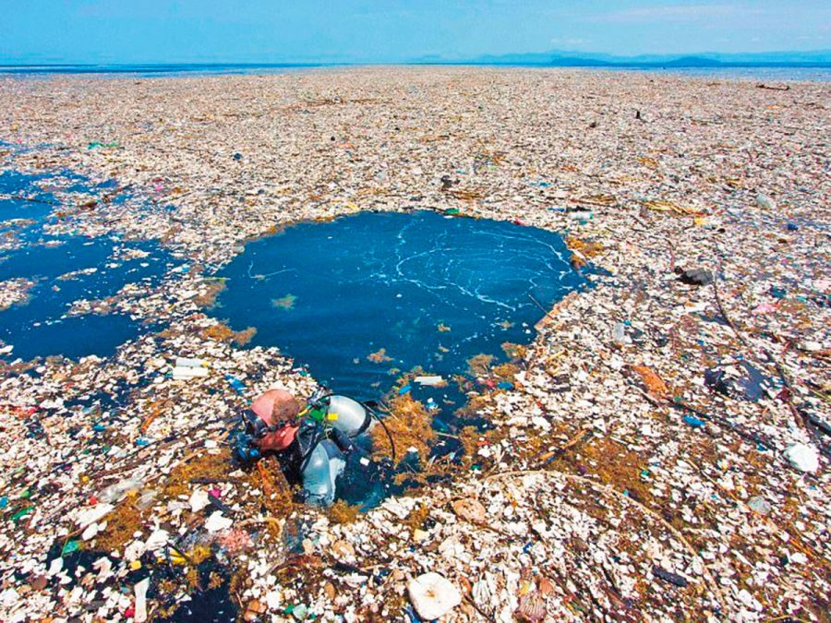
Ocean pollution
<NATURE> magazine :
“Garbage patch” 44 times
bigger than Taiwan .
Trap fish , or even eat them .

Slide 6
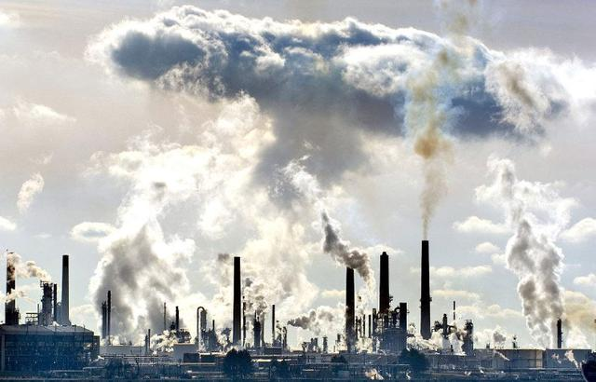
Effects to environment
ocean pollution
Air pollution

Slide 7
Air pollution
Greenhouse gas
Dioxin

Slide 8
Outline
1.effects to environment
2.effects to ourselves
3.ways to improve

Slide 9
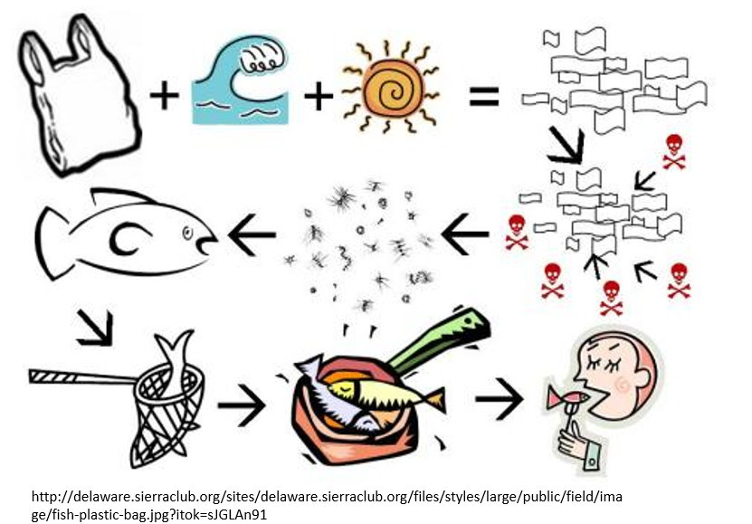
Effects to ourselves
Food chain

Slide 10
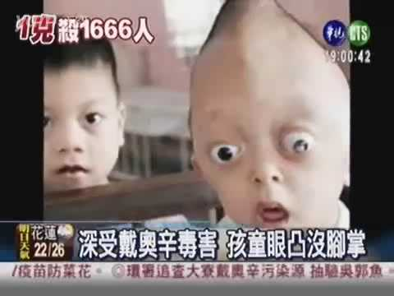
Effects to ourselves
Food chain
Effects on Next generation

Slide 11
Outline
1.effects to environment
2.effects to ourselves
3.ways to improve

Slide 12
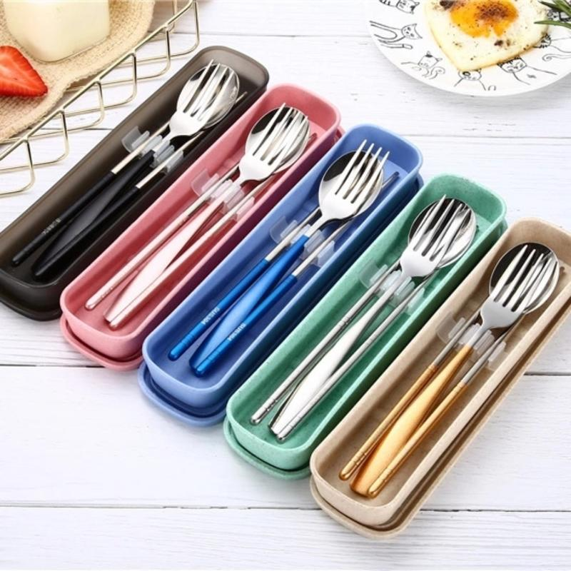
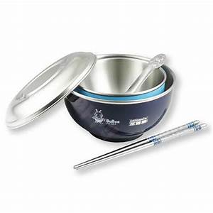
Ways to improve
Reduce : prepare own
talbeware .
Recycle
Beach cleanup

Slide 13

Ways to improve
Reduce
Recycle : better garbage
classfication
Beach cleanup

Slide 14
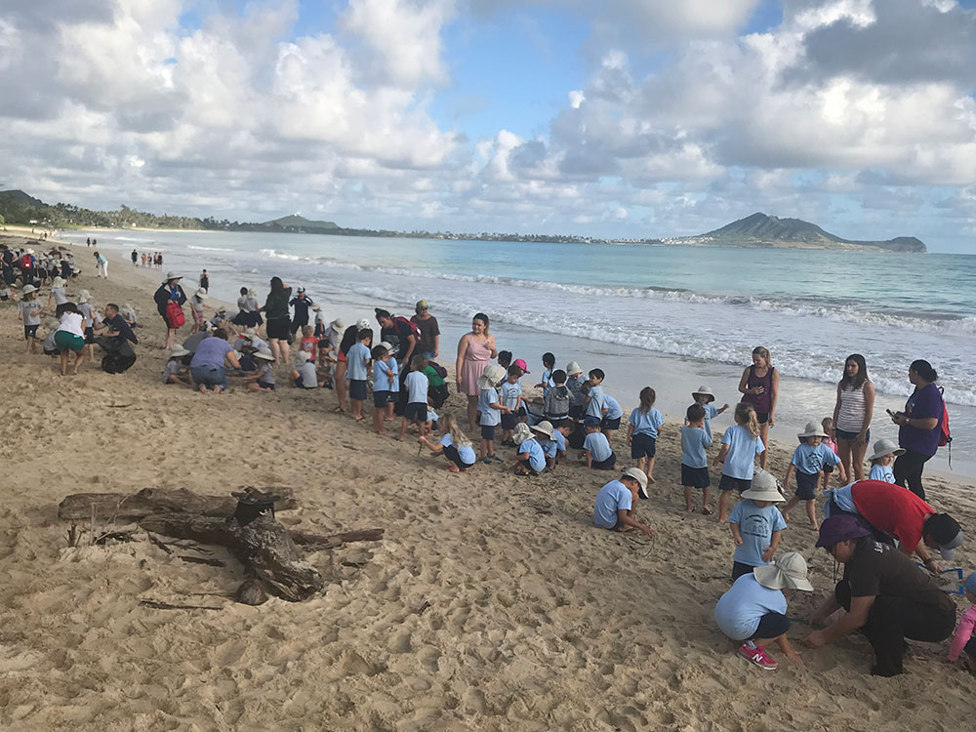
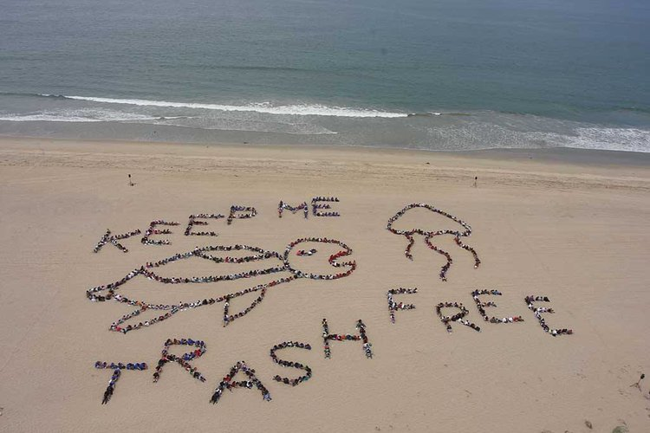
Ways to improve
Reduce
Recycle
Beach cleanup:
Many a little makes a mickle

Slide 15
Conclusion
1.effects to environment
2.effects to ourselves
3.ways to improve

Slide 16
END

